Slide 1

Executive Summary Airlines Safety

Slide 2
Contents
Airline Industry – Now!
Airline Industry Statistics
USA Airline Industry – Safer?
USA vs Rest Of World
Conclusion

Slide 3
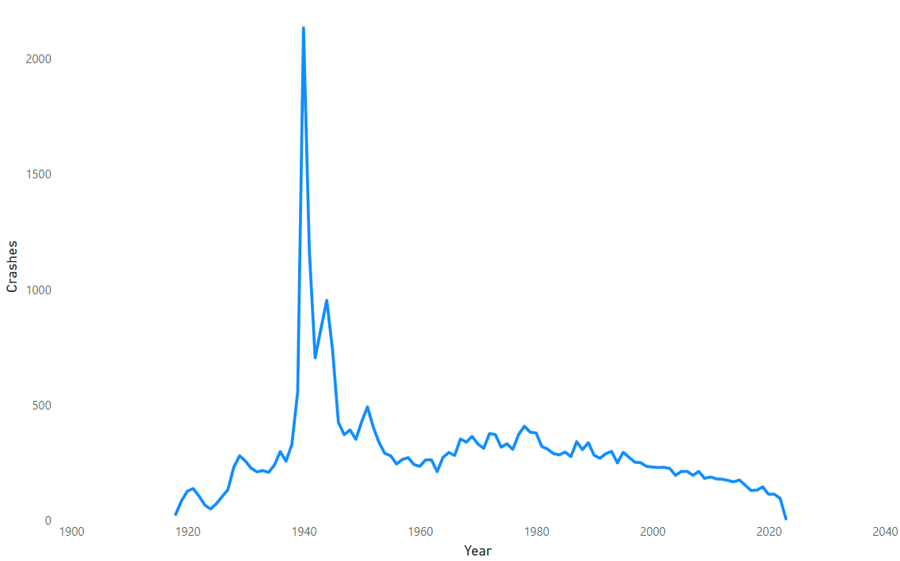
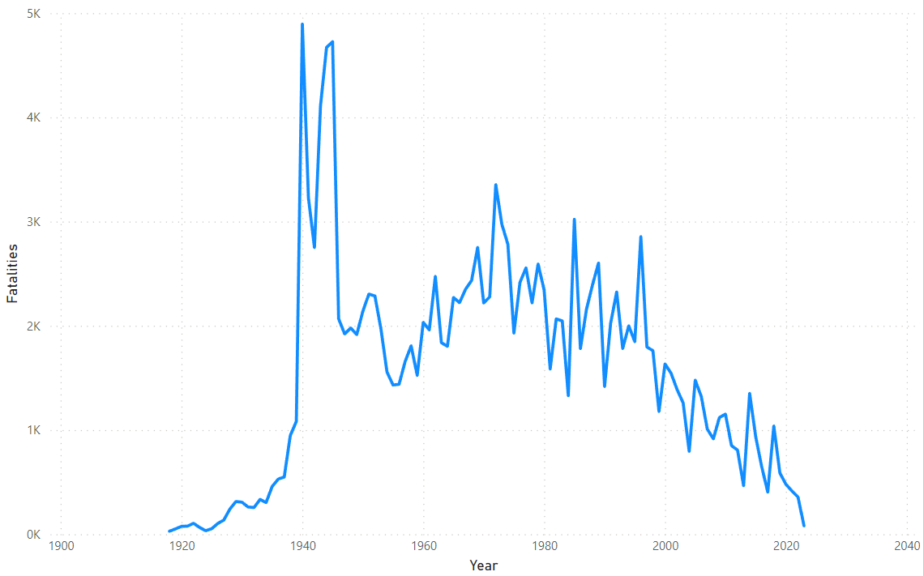
Airline Industry – Now!
If you see the number of crashes across years you can clearly see a downward trend.
If you see the number of fatalities, we can clearly see that starting from 2000 there has been a smaller number of fatalities compared to previous years.
We know that people using flights has increased over the years and the reduction in the number of fatalities clearly point to better security features and compliance compared to previous generations.
Airline Crashes over the years
Airline Fatalities over the years

Slide 4
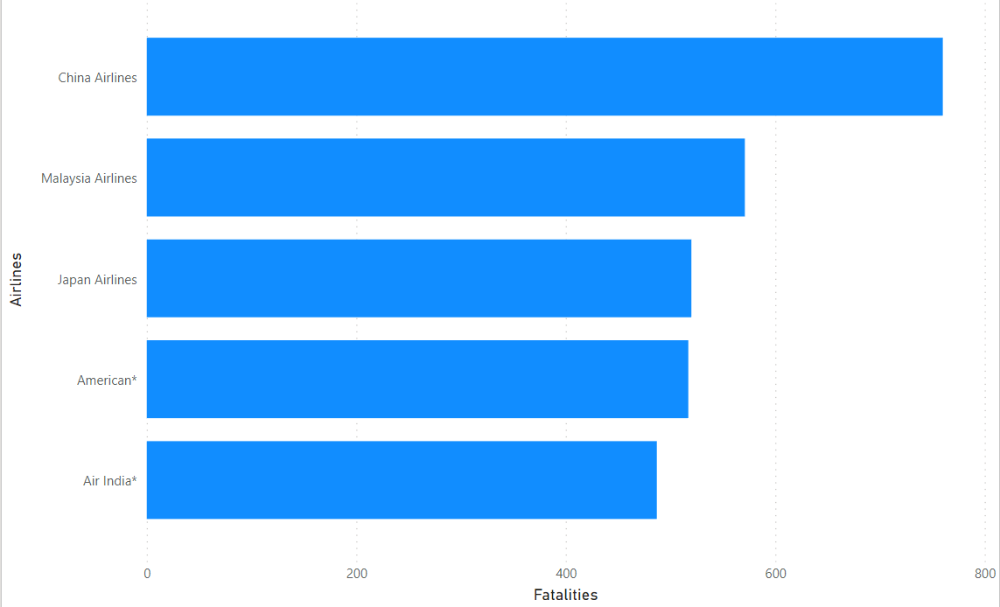
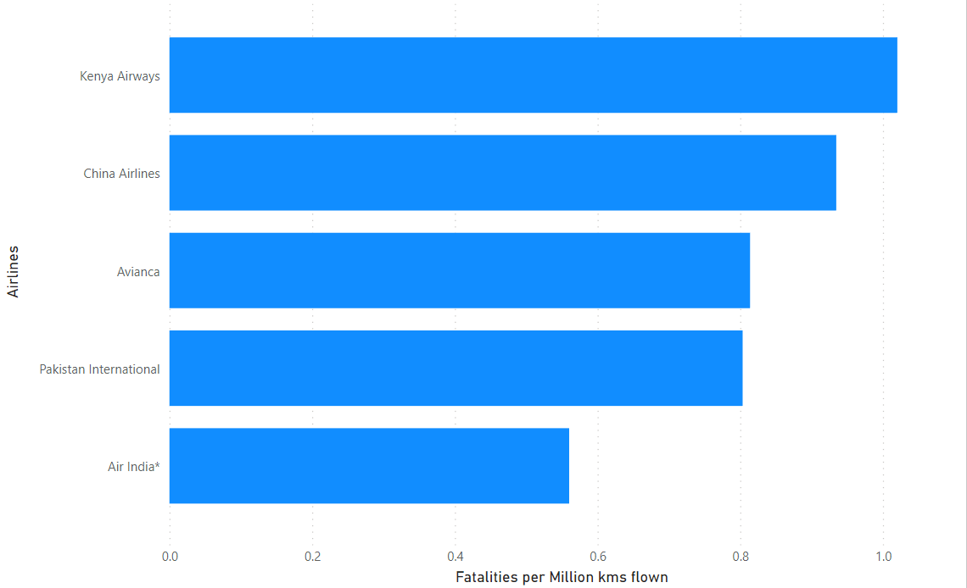
Airline Industry Statistics
If we see the top 5 airlines by number of Fatalities we can see that there is just one USA Airline - American Airlines.
But the right comparison should be the number of Fatalities per kms flown and as we can see there are no USA airlines in the top 5 and in fact is at the bottom of the list.
Fatalities by Airlines
Fatalities by Airlines per million kms flown

Slide 5
USA Airline Industry – Safer?
If we compare the number of fatalities in the years 1985 – 1999, it was 1051 for Airlines and 644307 for cars.
If we compare the number of fatalities in the years 2000 – 2014, it was 687 for Airlines and 576546 for cars.
We can see there is a downward trend for both airlines and cars but airlines have far fewer fatalities than cars in fact the ratio is around 700:1.
Total Number of USA Fatalities between 1985 and 2014
1220853 (Auto)
1738 (Airline)

Slide 6
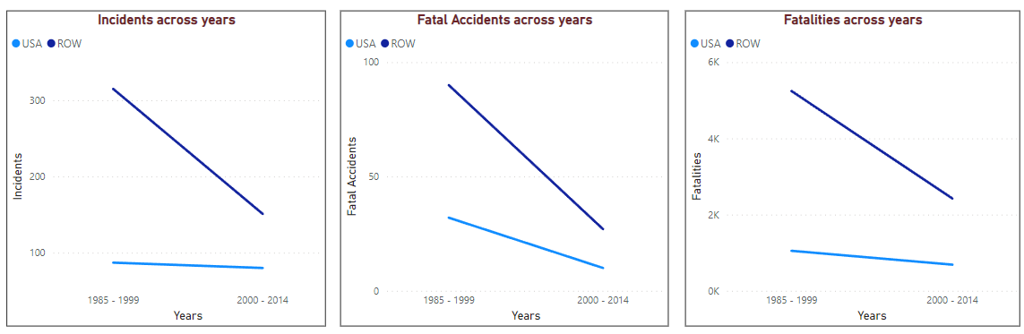
USA vs Rest Of World
If we compare USA to Rest Of World (ROW) we can clearly see that USA Airlines have less number of Incidents/ Fatal Accidents/ Fatalities across years.
Overall number of Incidents/ Fatal Accidents/ Fatalities across years has reduced for both USA and ROW Airlines which is again due to the improved security features and compliance but the clear trend is that USA Airlines are far safer than other airlines.

Slide 7
Conclusion
Recent airlines crashes can give an impression to the general public that airlines are not safer.
But in recent decades the number of incidents and fatalities have decreased considerably in the industry worldwide.
Even within the Airline Industry, USA Airlines have far fewer incidents and fatalities compared to other airlines when we consider the number of kms flown.
Comparing USA Auto and Airline statistics we can clearly see that the number of fatalities in the Auto industry are in the ratio of 700:1 to the Airline Industry.
Comparing USA to Rest Of World (ROW) airlines we can again see far fewer incidents and fatalities thereby proving that USA Airlines are far safer than others.

